Slide 1


Walmart Super Store Sales Analysis
By : SHRIRAM M

Slide 2
Agenda
Objective
Background
Reports
Inferences
Key Findings
Recommendations
Assumptions

Slide 3
Objective
To identify top products that contribute to the revenue
Analyze customer purchase behavior to estimate what items are more likely to be purchased individually or in combination with some other products
Visualizing sales and profit using various parameters.
Creating a detailed report.

Slide 4
Background
Walmart Inc. is an American multinational retail corporation that operates a chain of hypermarkets, discount department stores, and grocery stores in the United States, headquartered in Bentonville, Arkansas.
The company was founded by brothers Sam and James "Bud" Walton in nearby Rogers, Arkansas in 1962 and incorporated under Delaware General Corporation Law on October 31, 1969. It also owns and operates Sam's Club retail warehouses.
Walmart is the world's largest company by revenue, with about US$570 billion in annual revenue, according to the Fortune Global 500 list in October 2022. It is also the largest private employer in the world with 2.2 million employees. It is a publicly traded family-owned business, as the company is controlled by the Walton family. Sam Walton's heirs own over 50 percent of Walmart through both their holding company Walton Enterprises and their individual holdings. Walmart was the largest United States grocery retailer in 2019, and 65 percent of Walmart's US$510.329 billion sales came from U.S. operations.

Slide 5
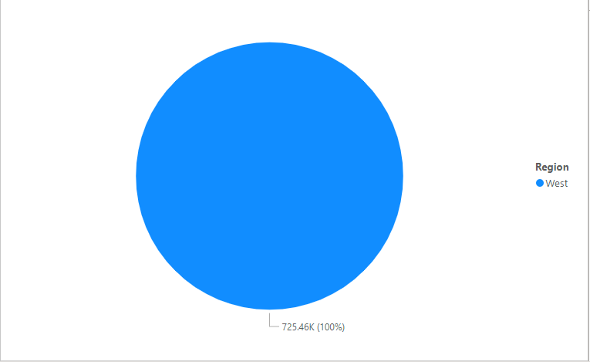
Sales By Region
West region of America has highly contributed for the sales.

Slide 6
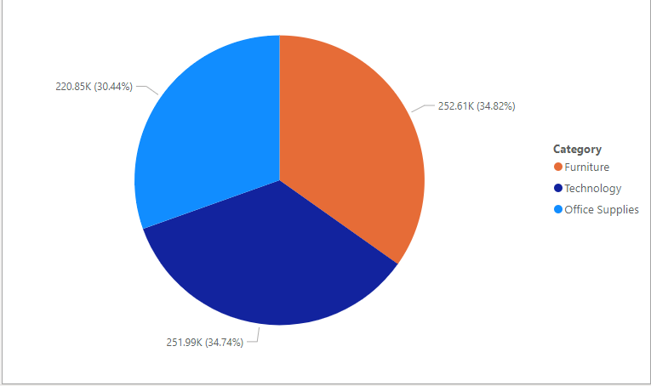
Sales by Category
Furniture from Category has contributed the most for the sales.

Slide 7
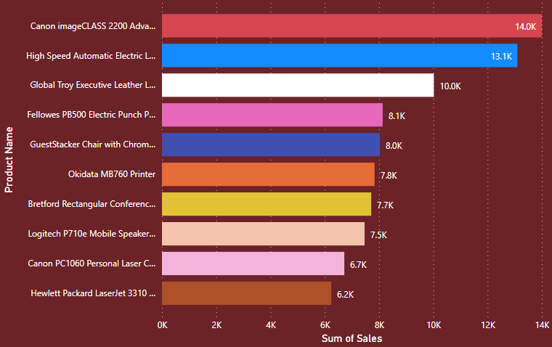
Sales By top 10 Products
Canon image CLASS 2200 Advanced copier is the product that has been highly sold in the market.

Slide 8
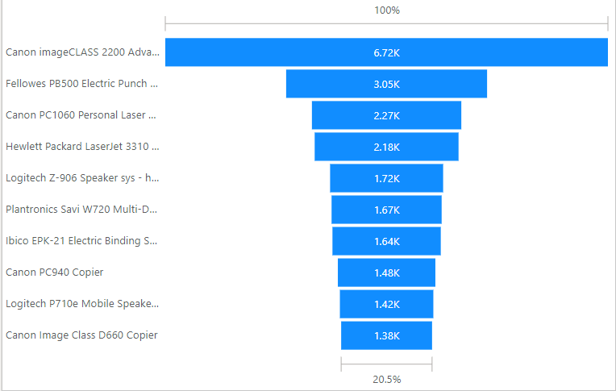
Top-10 Products by profit
Canon image CLASS 2200 Advanced copier has contributed highly to the profit.

Slide 9
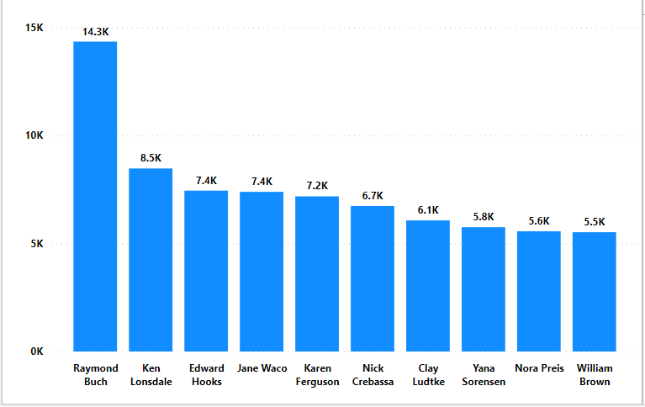
Sum of Sales of top 10 Customers
Raymond Buch has contributed the most for the sales of the company.

Slide 10
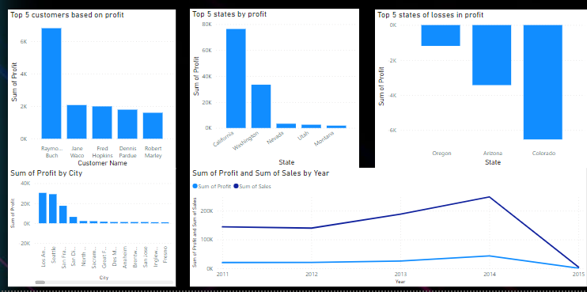
Customer, geographic and year wise analysis based on profit

Slide 11
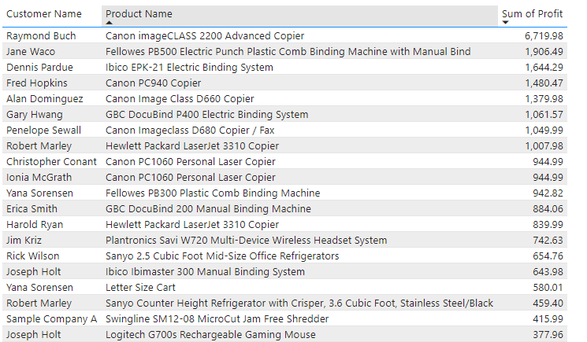
Sum of profit of top 20 products and their customers
As seen in the previous slides canon image CLASS 2200 Advanced copier has contributed highly to the sales as well to the profit of the company.

Slide 12
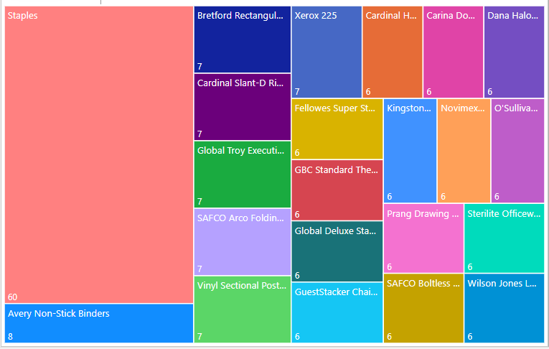
Top-20 Products by Number of Orders
The most ordered product has been Staples. It has been ordered 60 times.

Slide 13
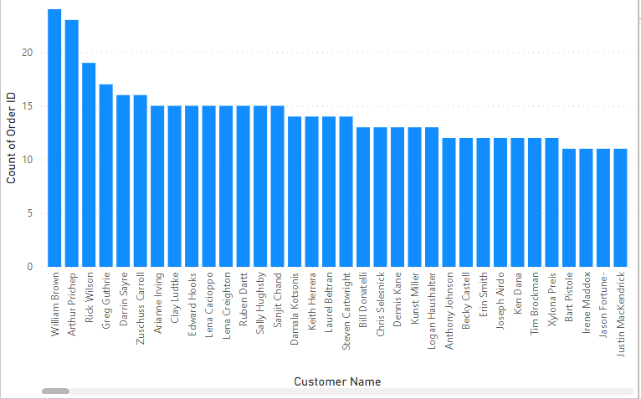
Customers who have ordered more than 10 times

Slide 14
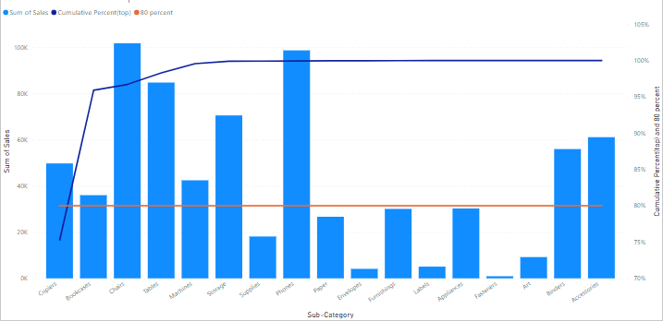
Sub Categories contributing to 80% Sales

Slide 15
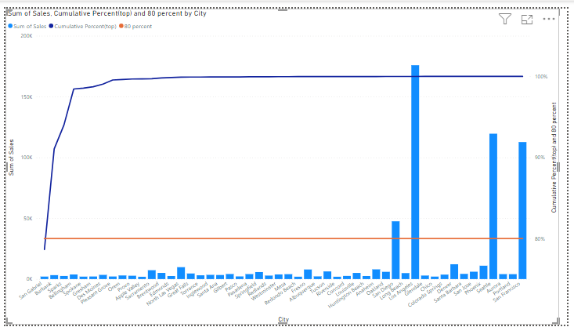
Cities contributing to 80% Sales

Slide 16
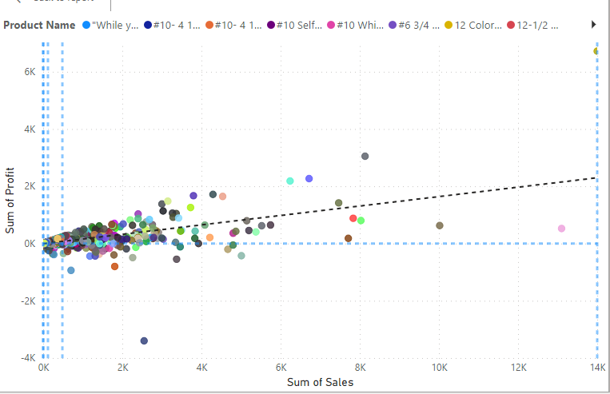
Trend Analysis using Scatter Plots

Slide 17
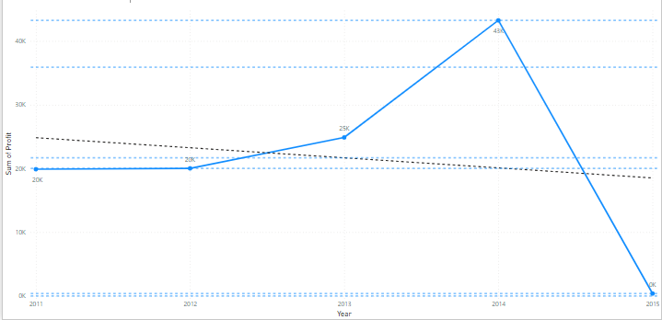
Profit Analysis-Year Wise

Slide 18
Reports
The total number of customers who have been part of the sales are 686.
2. A total of 3203 orders have been placed.
3. The sum of sales is 7,25,460 US$.
4.The sum of profit is 1,08,420 US$.
5. A total of 12,000 quantities have been sold.

Slide 19
Inferences
1.Chairs from the sub category has contributed the most to the sales.
2.Copiers from the subcategory has contributed the most to the profit.
3.Furnitures have contributed the most to the sales and office supplies have contributed the most to the profit.
4. California is the state that has contributed the most to the profit.
5. Los Angeles is the city that has contributed the most to the profit.
6. Colorado is the state that has contributed the most to the loss.
7.2014 is the year with the highest amount of sales and profit.
8. 2012 is the year with the lowest amount of sales and profit.
9. December 2013 and 2014 are the months that have contributed the most to the sales of the company and 2014 march has contributed the most to the profit of the company.

Slide 20
Key Findings
Furniture category has been consistently performing well in the sales.
In the year 2014,sales have gone higher as far as all the three categories are concerned, i.e Office supplies, furniture and Technology.
A significant amount of discount has been given on all three categories.
Whereas in the year 2012 the amount of sales have drastically gone down.
An inflation rise of 2.07% in the US might have caused a slight dip on the sales whereas the subsequent years the inflation rates got reduced to 1.46% and 1.62%.
Due to that, year 2013 and 2014 have boosted the sales and profit of the company.

Slide 21
Recommendations
Target customers belong to the furniture category where people belonging to all the age groups boost up the sales as they are the most ordered category over the period of 5 years.
For all these 5 years furniture category has been consistently boosting the sales.
Offer,Promo-codes or discounts on frequently ordered category associations and the most ordered products to attract more customers.

Slide 22
Assumptions
No orders were placed on 2015. But few orders which have been placed in the year 2014 , got shipped in the year 2015.
In certain cases I have also taken 2015 as a year for analysis.

Slide 23
Thank You.

